Slide 1
MyLivingCity
Project Report
Muyuan Ma
Zihao Huang
Yushun Cheng

Slide 2
Objectives
Create user-friendly comment processing features
Comment Funnel Function
Input Filtering System
Summation Comment Display
Gauge Statistics and Display Dashboard

Slide 3
Comment Funnel Function
Processing Flow
Sentiment Analysis
Comments
Model
(LLaMA3)
keywords…
Database
Cross Comparison

Slide 4
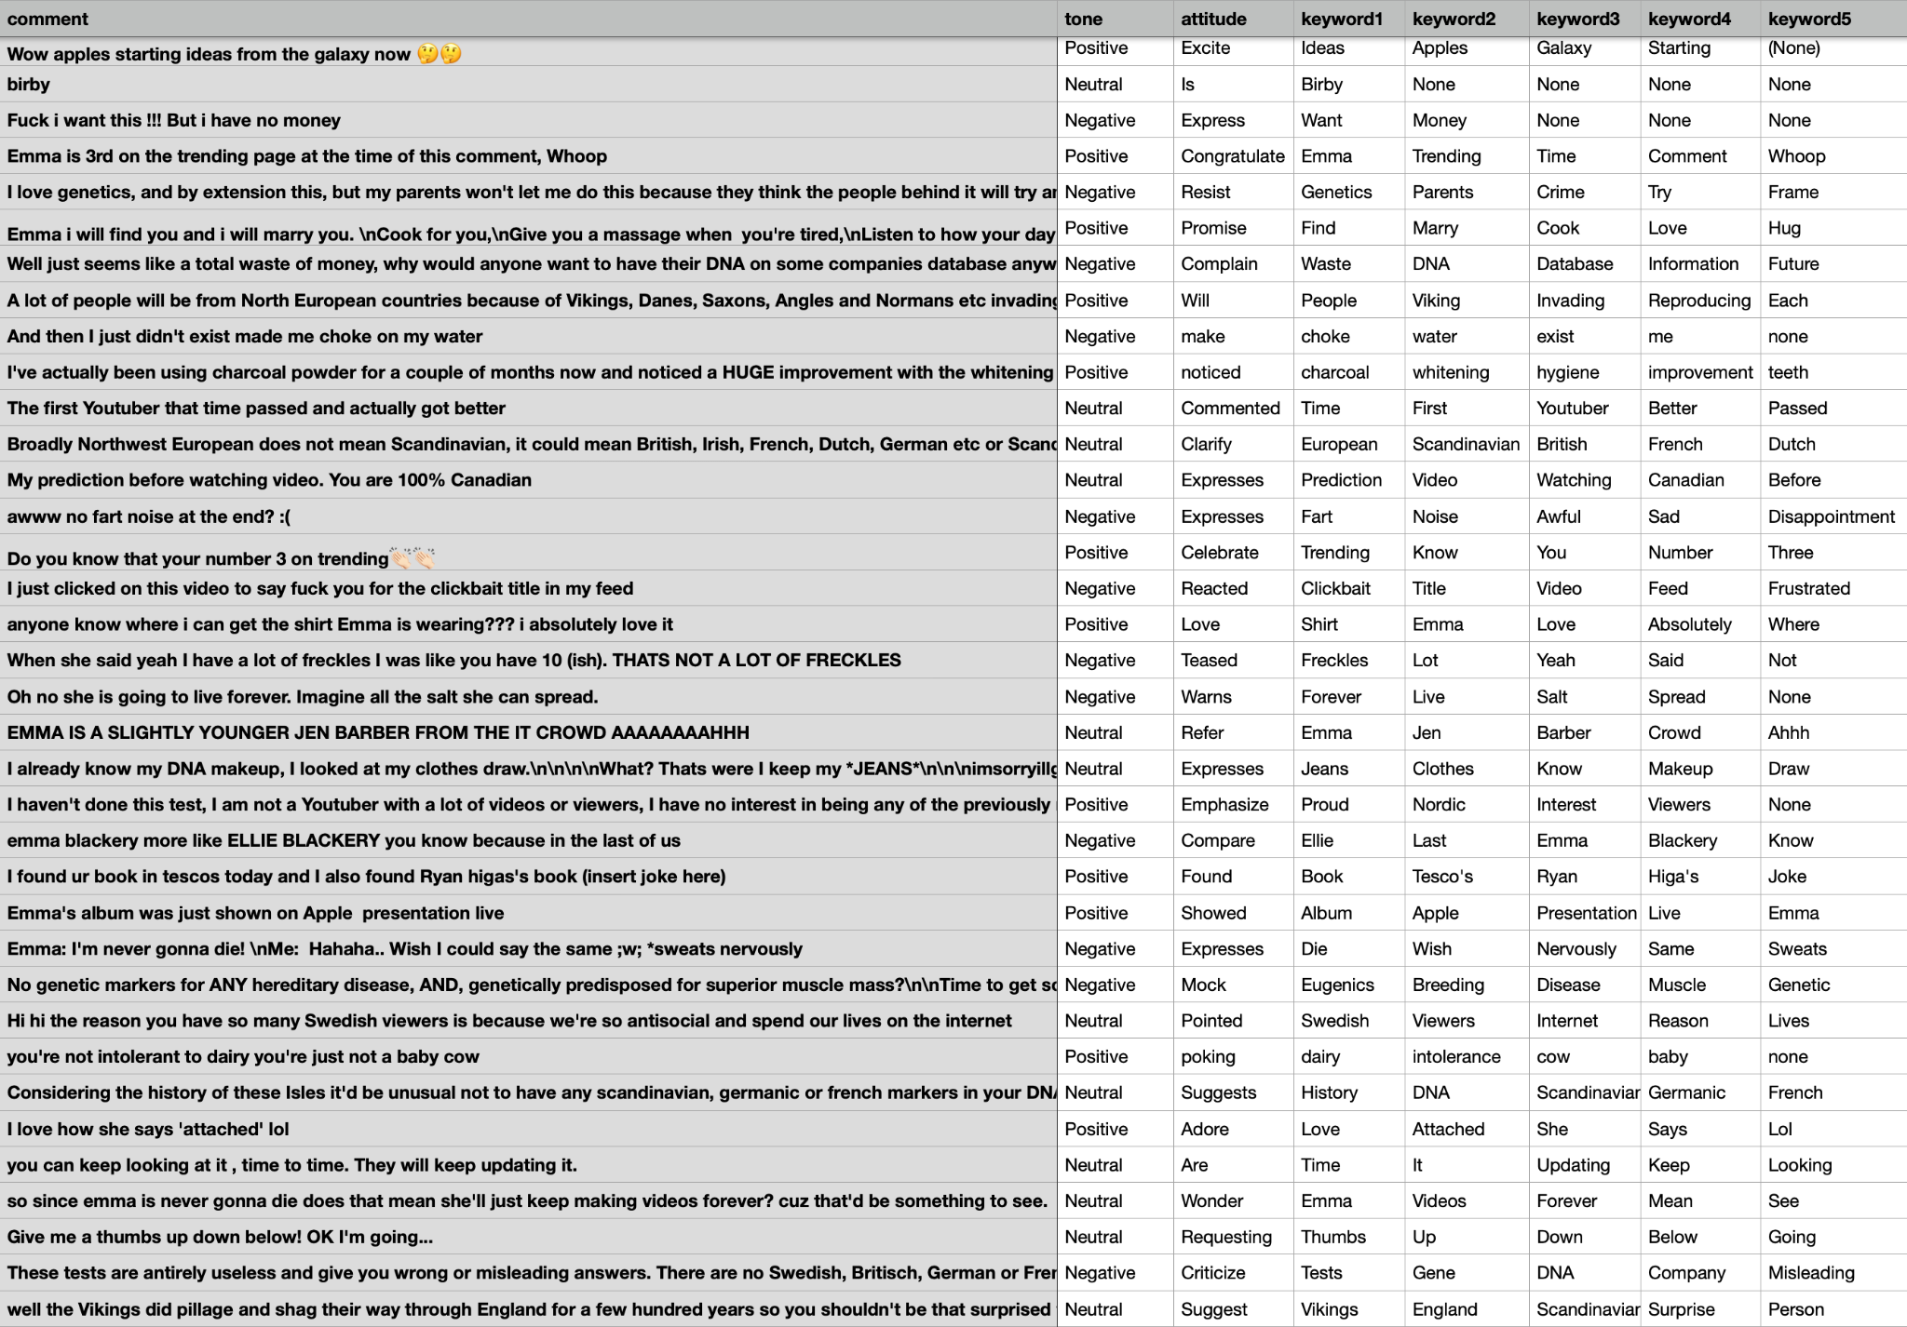

Slide 5
Comment Funnel Function
Model Performance
Stable and with outstanding performance
Accurately extract information from a small amount of text
Understand informal terms
Internet slang
Emoticons and Stickers
Emoji

Slide 6
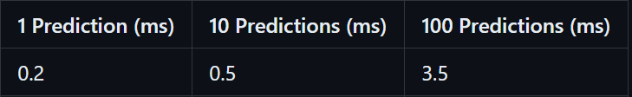
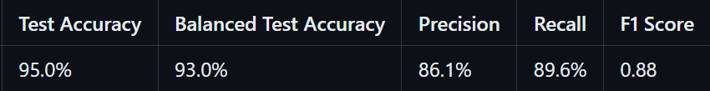
Input Filtering System
Design:
Vectorization(Bag of Words)
Linear SVM
Highlights:
Fast and robust
Simple structure, easy to re-train or modify according to future demand
No bad word list required, learns by itself

Slide 7
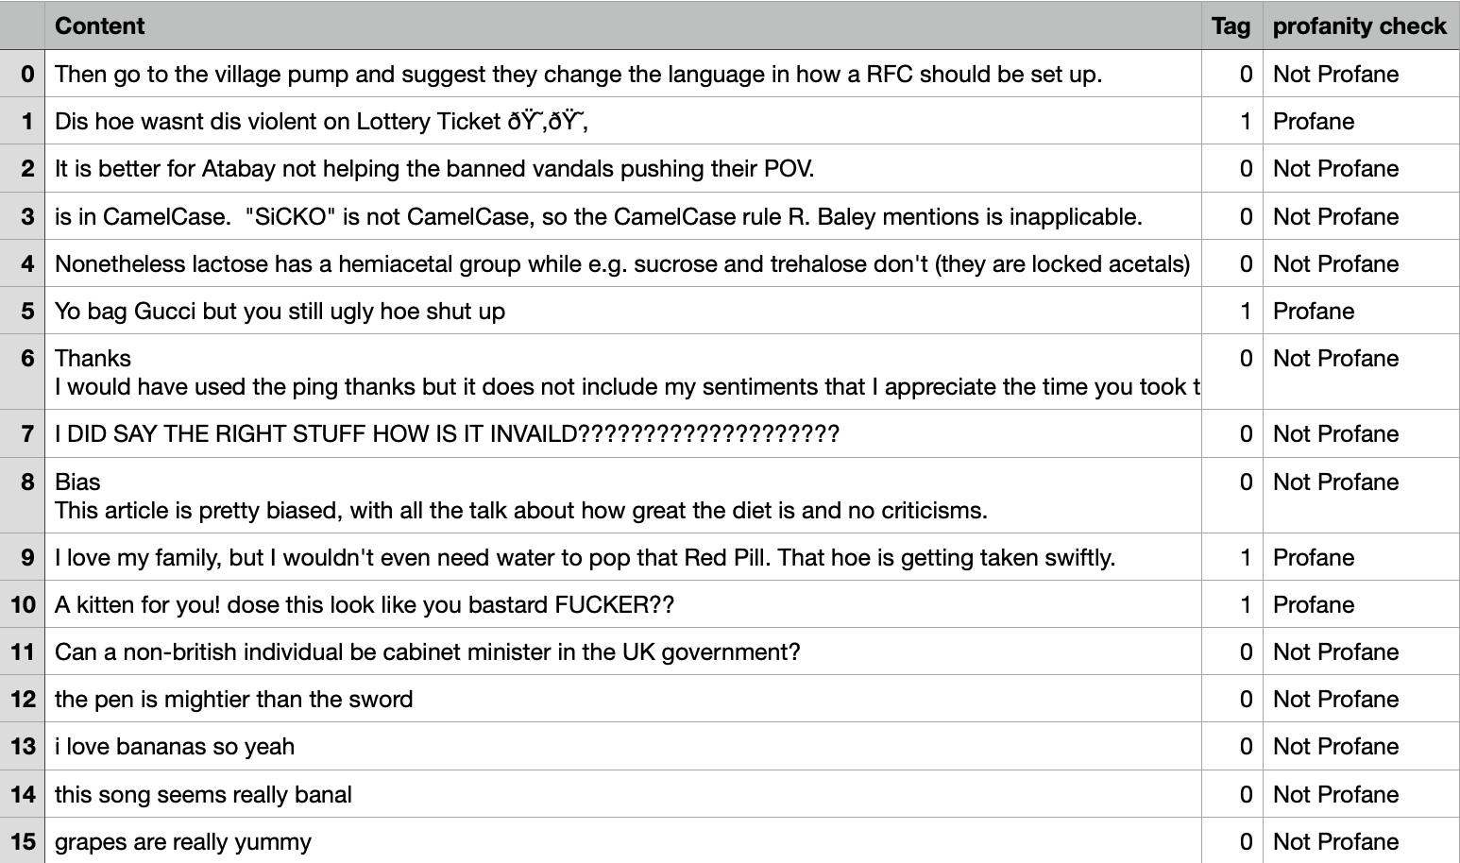

Slide 8
Summary Comment Display
Processing Flow
Comments
(combination)
Topic
Matching
Model
(LLaMA3)
Summarization
Database

Slide 9
Summary Comment Display
Results
The video appears to be about iPhones, with many commenters sharing their opinions and experiences. Some praise Apple's products, while others criticize them or compare them to Samsung phones. There are also mentions of Steve Jobs and Wozniak, as well as jokes and sarcasm about the cost of iPhones.
The video discusses DNA test results and their accuracy. Viewers share their own experiences with DNA tests, including finding Scandinavian heritage and being related to celebrities like Emma herself. The comments also touch on topics like genetic health risks, false information from certain testing labs, and personal preferences for furniture.
The comments section of this video is filled with diverse reactions, including laughter, relatability, and confusion. Some users appreciate the humor, while others find it annoying or not funny at all. There are also comments that stray off-topic, share personal stories, or promote other YouTube channels or products.

Slide 10


Integration & API Setup
Limited by server performance,
API is a better way to deploy the functions.
The low price allows us to summarize more than 2,000 comments for only $0.08.

Slide 11
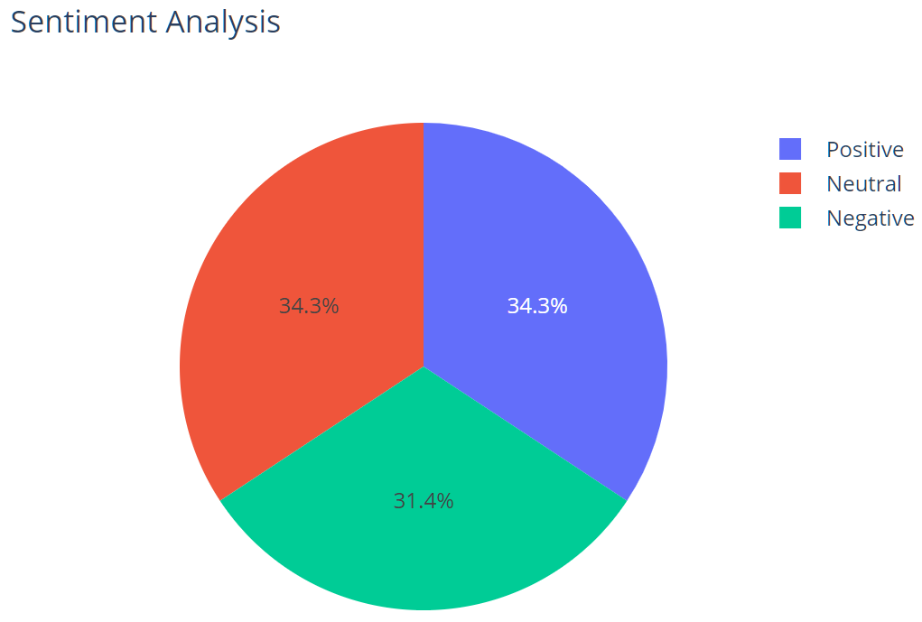
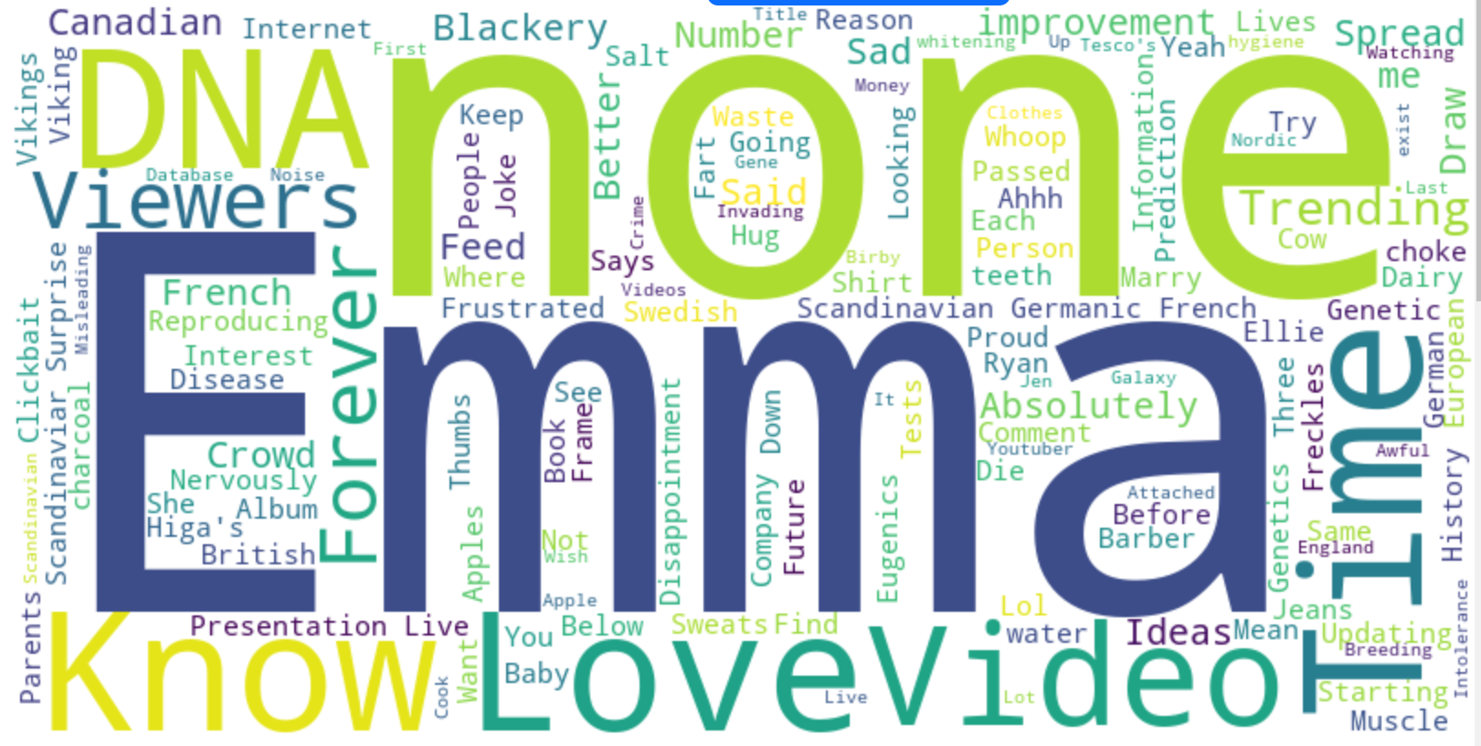
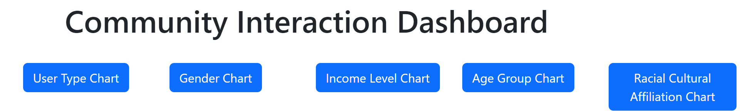
Dashboard
Dashboard
Dashboard
Charts:
Sentiment Analysis (Tone) Pie Chart
User Type Distribution Pie Chart
Gender Distribution Pie Chart
Income Level Distribution Pie Chart
Age Group Distribution Pie Chart
Racial/Cultural Affiliation Distribution Pie Chart
Word Cloud:
Visual representation of keyword frequency
Interactive Elements:
Buttons to toggle chart visibility
Real-time updates and feedback
Notes:
Welcome to our municipal proposal dashboard. This tool offers a comprehensive overview of public attitudes toward each proposal by leveraging past user comments. The word cloud feature highlights the most frequently used words in historical comments, giving users quick insights into common themes. Additionally, our sentiment analysis chart further illustrates the overall tone of these comments.
Our dashboard also includes charts that visualize the distribution of various demographics, including income levels, age, gender, ethics, and user types. These visualizations provide valuable information, helping users understand the diverse perspectives of the community.

Slide 12
Thank you

